Slide 1
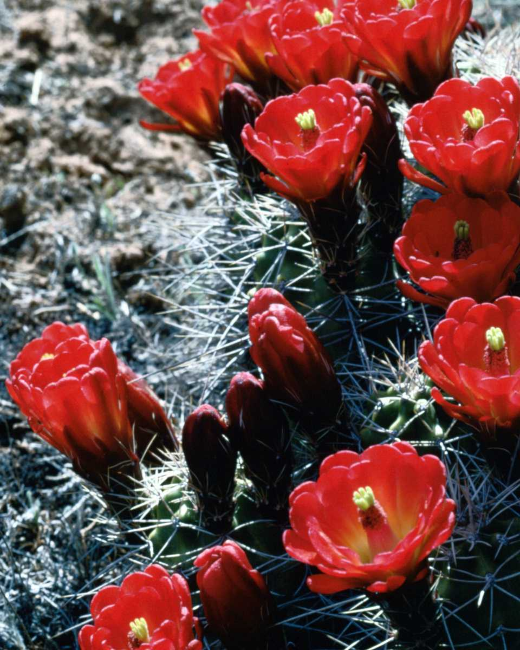
RESEARCH METHODOLOGY

Slide 2

Formulation of hypothesis
1.Xerophytes have thick, succulent habit
2.Chemical evidence is the last word for plant systematics
3.All the animals have hairs and are adapted to artic life

Slide 3
How to define an objective?
Search the available literature
If it reveals that the idea has already been tested
Drop the idea and go for another one
Otherwise precise the objective to explore the undocumented point

Slide 4
Difference between aim and objective
Aims point out the general purpose of the study
Objectives spell out exactly what one intends to do in the study

Slide 5
Make the objective simple, unambiguous and precise

Slide 6
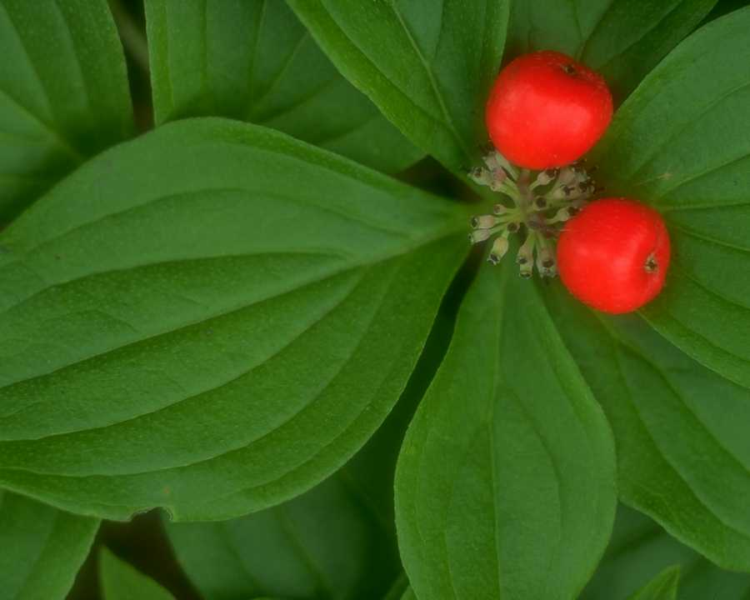
Protocol Writing
Maintain a log book where all the events pertaining to the dissertation work can be entered.
The protocol is a formal or official transaction or proceeding.
It contain
A well defined aim and objective
Relevant literature
Details of study design
Methodology and data collection
Out come of research and usefulness

Slide 7
Basic principles of experimental design
The principle of replication
The experiment should be repeated more than once.
The statistical accuracy is increased.
Replication helps to increase precision.

Slide 8
The data
Two Types of data
Primary – those which are collected fresh and for the first time
Secondary – those have already been collected by someone else

Slide 9
Methods of data collection
Primary data
Observation method- most common
Interview method- face to face contact
Through questionnaires – popular in surveys
Using mechanical devices - photographs
Content analysis- analyzing documents

Slide 10
Secondary data
Publications
Reports and journals
Books, news papers

Slide 11
Selection of the method depend upon
Nature, scope and objective of the study
Availability of funds
Time factor
Precision required

Slide 12
Representation of data
Tables
Primary presentation of data
Simple self explanatory , compact and readily understandable

Slide 13
The table
Have a number (Table.1,2,3…..)
Short self explanatory title
All columns have headings
Mentioned the units
Alignment of rows and columns are perfect

Slide 14
Table.1. Crude fibre content in certain vegetables
Scientific name
Crude fibre content (%)
Range
Mean
1. Capsicum annuum
0.8 - 1.5
1.0
2.Trichosanthus anguina
1.0 - 2.1
1.8
3. Lufa acutangula
0.7 - 2.6
1.5
4. Benincasa hispida
0.5 - 1.2
0.8
5.Cephalandra indica
0.7 - 2.2
1.6

Slide 15
Figures
Secondary presentation to highlight the important data
Selection of the figure depends up on the type of data
The figure may be

Slide 16
A bar diagram

Slide 17
A graph

Slide 20
Review concepts and theories
Define research problem
Formulate hypothesis
Design research
Collection of data
Analysis of data
Interpret and report
Review previous research finding
Research process in flow chart

Slide 21
Computers and researches
Word processing
Performing calculations
Data analysis
Data storage
Graphics

Slide 22
Questionnaire design
Relevant to requirements gathering for, and evaluation of projects
Self study pack by Arthur Rothwell covers:
Planning and logistics of questionnaire design
Layout issues
Forms of questions
Contents of questions

Slide 23
Planning and logistics of questionnaire design
Quantitative or qualitative?
Legal requirements: the Data Protection Act
Confidentiality and anonymity
Sample size
Volunteer respondents
Identifying subject areas
Determining appropriate length
Typical time scale
Main components of questionnaires

Slide 24
Forms of question
Open and closed questions
Dichotomous items
Scaled items
Mid-point or no mid-point?
Ranking to show preference
Notes:
dichotomous - divided or dividing into two sharply distinguished parts or classifications

Slide 25
Components of Research Design The Basic Steps
A) The Research Question
B) The Theory
C) The Model
D) The Data
E) The Use of the Data

Slide 26
5 Elements of a Research Proposal
Problem statement
Motivation: Raise the research question
Define the question
Benefit of solving the problem
Previous/Related work
What do we already know about the problem?
How would the proposed research increase our knowledge?
Research plan
How do you plan to solve the problem?
Justify your plan (analytical, preliminary results)
Evaluation plan
Research management
Schedule, milestones, fallback plans
Resource needs

Slide 27
“A clever person solves the problem But a wise person avoids the problem” Albert Einstein

Slide 28

Thank You
Look forward to learning more about this wonderful topic with you…

